Slide 1
Databases 2
SQL

Slide 2
Agenda
Group By / Having
IN / EXISTS
Subquery
Joins

Slide 3
Group By / Having
What does GROUP BY do?
What does HAVING do?
Notes:
Wie weet er nog wat GROUP BY / HAVING doet?

Slide 4
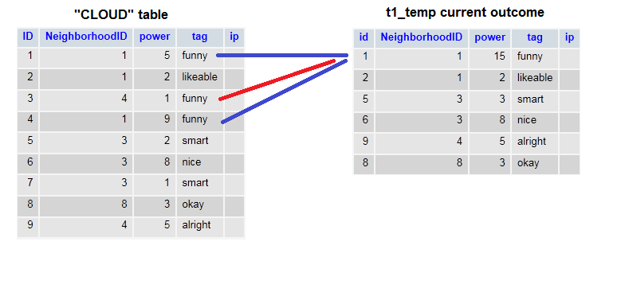
Group By

Slide 5
Group By
Notes:
Hoe is de power 15 geworden? SUM. Gebeurt niet vanzelf

Slide 6
Group By
Msg 8120, Level 16, State 1, Line 3
Column 'CLOUD.power' is invalid in the select list because it is not contained in either an aggregate function or the GROUP BY clause.
Notes:
Dit gebeurt er als je niet een aggregate functie gebruikt, of in de GROUP BY zet.

Slide 7
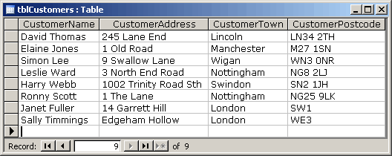
Group By / Having
SELECT * FROM tblCustomers
Notes:
Hoe haal ik het aantal personen per CustomerTown op?

Slide 8
Group By / Having
SELECT * FROM tblCustomers
GROUP BY CustomerTown

Slide 9
Group By / Having
SELECT * FROM tblCustomers
WHERE COUNT(ID) > 1
GROUP BY CustomerTown
Notes:
Toch? NEE!

Slide 10
Group By / Having
SELECT * FROM tblCustomers
WHERE COUNT(ID) > 1
GROUP BY CustomerTown
Msg 147, Level 15, State 1, Line 2
An aggregate may not appear in the WHERE clause unless it is in a subquery contained in a HAVING clause or a select list, and the column being aggregated is an outer reference.
Notes:
Toch? NEE! + Order of execution

Slide 11
Group By / Having
SELECT * FROM tblCustomers
GROUP BY CustomerTown
HAVING COUNT(ID) > 1

Slide 12
IN / EXISTS
IN will process every row from the inner query.
EXISTS will stop scanning if there is a match
Notes:
Which is faster?

Slide 13
IN
IN will process every row from the inner query
var arr = [1,2,3,4,5];
var counter = 0;
foreach(int number in arr)
{
counter++;
}

Slide 14
IN
IN will process every row from the inner query
Can use subqueries and literal values
SELECT * FROM Species s WHERE s.Age IN (
26, 27, 28
)

Slide 15
EXISTS
EXISTS will stop scanning if there is a match
var arr = [1,2,3,4,5];
bool inArray = false;
foreach(int number in arr)
{
if(number == 5)
{
inArray = true;
break; // Stop the loop
}
}

Slide 16
EXISTS
EXISTS will stop scanning if there is a match
Uses subqueries
SELECT [Name] FROM Species s WHERE EXISTS (
SELECT Age FROM Species s2
WHERE s2.Age = s.Age AND s2.ID <> s.ID
)
Notes:
Wat doet deze query? Wat zijn de blokhaken om Name? Wat is <> ?

Slide 17
EXISTS
EXISTS will stop scanning if there is a match
Uses subqueries
SELECT [Name] FROM Species s WHERE EXISTS (
SELECT Age FROM Species s2
WHERE s2.Age = s.Age AND s2.ID <> s.ID
)
SELECT [Name] FROM Species s WHERE s.Age IN (
SELECT Age FROM Species s2
WHERE s2.Age = s.Age AND s2.ID <> s.ID
)
Notes:
Hetzelfde maar dan IN. Gebruik de snellere variant indien mogelijk.

Slide 18
EXISTS
EXISTS will stop scanning if there is a match
Uses subqueries
SELECT [Name] FROM Species s WHERE EXISTS (
26, 27, 28
)
SELECT [Name] FROM Species s WHERE s.Age IN (
26, 27, 28
)
Notes:
Wordt omgezet naar dit

Slide 19

Notes:
Venn-chart

Slide 20
SQL Joins
NATURAL JOIN
CROSS JOIN
(INNER) JOIN
LEFT (OUTER) JOIN
RIGHT (OUTER) JOIN
FULL (OUTER) JOIN

Slide 21
SQL - Joins – NATURAL Join
Joins two tables based on a column with a “shared” name between two tables
SQL Server does not support it
Don’t use it, or do use it
Remember the “shared” columns

Slide 22
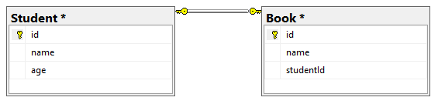
SQL - Joins – Example database
What kind of relationship is this?
What are the PK and FK of the relationship?
What kind of “information” (not data!) can we get from the database?
Notes:
1:N – PK: id – FK: studentId - How many people own more than 10 books?

Slide 23
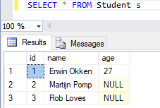
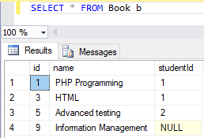
SQL - Joins – Example database
Notes:
1:N – PK: id – FK: studentId - How many people own more than 10 books?

Slide 24
SQL - Joins – CROSS Join
SELECT * FROM Student CROSS JOIN Book
SELECT * FROM Student, Book
How many rows does this query return?
Notes:
Returns count_table_1 * count_table_2;

Slide 25
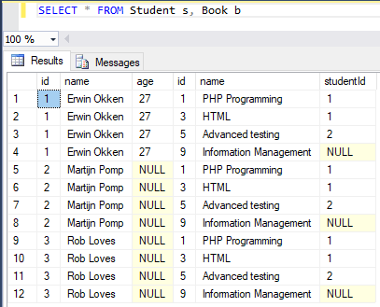
SQL - Joins – CROSS Join
SELECT * FROM Student s, Book b
Notes:
4 * 3 = 12

Slide 26
SQL - Joins – FULL Join
Joins two tables, regardless of the fact if there is a reference
Examples: Also returns student without book;
books without student

Slide 27
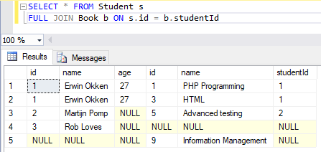
SQL - Joins – FULL Join

Slide 28
SQL - Joins – LEFT Join
Joins two tables, regardless of the fact if there is a reference from the left (first) table to the right (joined) table
Examples: Also returns students without book

Slide 29
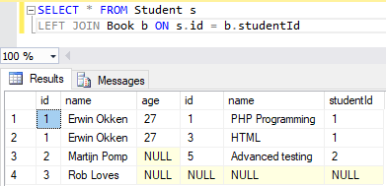
SQL - Joins – LEFT Join

Slide 30
SQL - Joins – RIGHT Join
Joins two tables, regardless of the fact if there is a reference from the right (joined) table to the left (first) table
Examples: Also returns books without student

Slide 31
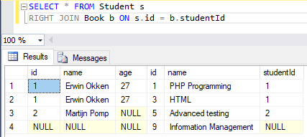
SQL - Joins – RIGHT Join

Slide 32
SQL - Joins – INNER Join
Joins two tables, only returns the rows where there is a reference from the left (first) table to the right (joined) table and vice versa
Examples: Only returns students that have books

Slide 33
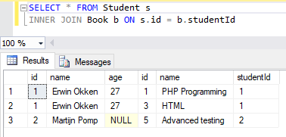
SQL - Joins – INNER Join

